Slide 1
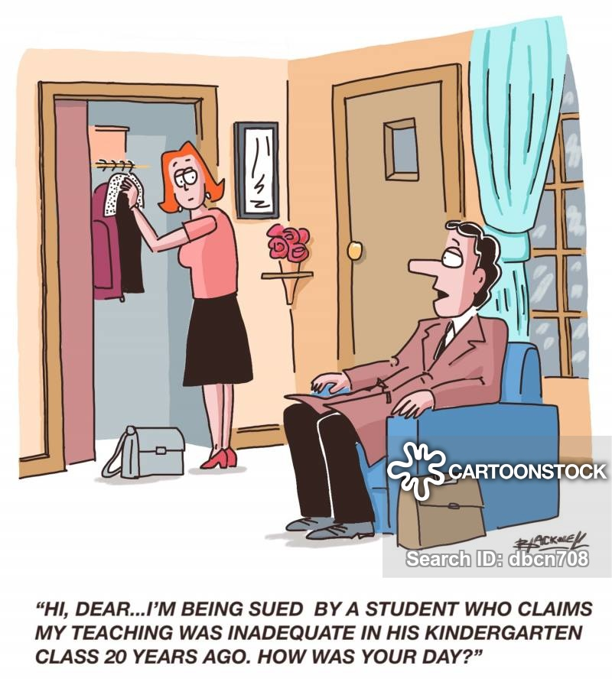
BELL RINGER
TORTS
A “tort” is defined as a civil wrong that causes someone to suffer harm or loss, creating legal financial liabilities by the person who has committed the act in question.

Slide 2
BELL RINGER
TORTS
Medical expenses, loss of income, repair costs, personal injury, and/or pain and suffering are examples of compensable losses.
With a criminal act, intent matters. By contrast, a defendant may be liable for damages in a tort case for an injury that he causes, even if it was an accident.

Slide 3
BELL RINGER
TORTS
The prosecutor in a criminal case charges John with battery for hitting Dan in the face with a swinging door. Dan, the victim, is called as the only witness and testifies that John pushed the door open very fast. But then he adds that he does not believe that John knew he was on the other side of the door.
Should the judge find John guilty of criminal battery?
No! There is no evidence that John intended to hit Dan with the door.

Slide 4
BELL RINGER
TORTS
The same case comes before the judge as a tort claim filed by Dan against John. Dan testifies that John opened the door very fast, hit Dan who was on the other side, and that Dan had to pay medical bills and lose a day’s work because of pain.
Can the judge order John to pay Dan for this damages?
Yes! Even if he did not intend to hurt Dan, John should compensate Dan for John’s carelessness.

Slide 5
BELL RINGER
TORTS
Jane is shopping in a supermarket. She turns suddenly to say hello to a neighbor, loses her balance and falls down, breaking her ankle.
Can Jane recover her medical bills, lost wages, and pain and suffering costs from the supermarket?
No! The supermarket didn’t do or fail to do anything that resulted in Jane’s fall.

Slide 6
BELL RINGER
TORTS
Jane is shopping in the supermarket. She turns the corner of the aisle and slips on some milk that has been spilled on the floor by a customer. A customer had reported the spill to an employee five minutes earlier, but the manager had decided he needed all his staff on the checkout lines and hadn’t gotten around to assigning anyone to clean it up.
Can Jane recover her medical bills, lost wages, and pain and suffering costs from the supermarket?
Yes! The supermarket owes a duty of care to its customers, and it breached that duty when its staff failed to remove a known hazard.

Slide 7
BELL RINGER
TORTS
Steve is walking down a crowded street and accidentally bumps into Joe. Steve mumbles an apology and starts to walk by, but Joe yells at him, "Get back here so I can punch you for shoving me." Joe never touches Steve, however.
Can Steve recover damages from Joe for assault?
Yes! Joe threatened Steve with an immediate assault. Steve can recover damages for his fear of being hit.

Slide 8
BELL RINGER
TORTS
Steve is walking down the street and bumps into Joe accidentally. Joe gives Steve a shove without saying a word. Steve is surprised but not injured.
Can Steve recover damages from Joe for battery?
Yes! Joe touched him in an offensive way, deliberately and without his consent. Although Steve ran into Joe first, this was not battery because it was not intentional and caused no harm.

Slide 9
BELL RINGER
TORTS
A painter is carrying her painting to a gallery for appraisal. A driver jumps the curb in his car. The side view mirror rips the painting out of the artist’s hand and into mud, destroying it.
Can the artist recover damages from the driver?
Yes! The driver’s carelessness and negligent handling of the car caused the painter to lose the value of her painting.

Slide 10
BELL RINGER
TORTS
Shelly is turning a corner in her car and is unexpectedly blinded by the sun. She keeps turning anyway and runs into Harry’s car, denting the front fender and headlight.
Can Harry recover damages from Shelly?
Yes! Shelly should have stopped driving when she knew she couldn’t see what was ahead of her. She failed to exercise reasonable care and caution.

Slide 11
BELL RINGER
TORTS
Hannah is driving down the street when a truck driving next to her starts moving into her lane. Hannah has no choice but to cross the centerline to avoid being hit by the truck. Her car sideswipes an oncoming car driven by Martha, causing damage to the doors of both cars; the truck drives on without stopping and can’t be found.
Can Martha recover damages from Hannah?
No! Hannah did nothing either negligently or intentionally harmful to Martha’s property. The truck driver would be liable for damages to both cars for negligent driving.

Slide 12
BELL RINGER
TORTS
Jennie slaps her daughter’s teacher, Anne, after the teacher accused Jennie’s daughter of cheating on a test. Distracted and humiliated, Anne drives home five hours later, runs a stop sign and gets into an accident that causes $3000 in damage to the other driver’s car, which Anne is required to pay. Anne sues Jennie for the tort of battery, and asks the court to award her the $3000 damages she had to pay the other vehicle owner for the accident.
Can Anne recover the $3000 from Jennie?
No! These damages are too remote in time and causation. There is a long period of time and a slim connection between the slap and the accident.

Slide 13
BELL RINGER
TORTS
Edward is stopped at a stop light with his window rolled down. Craig walks up to his car and, as a joke, sticks a toy gun to his temple. Edward is so scared he steps on the gas, runs the red light and slams into David’s car in the intersection.
Can Edward win a case against Craig for damages to his own and David’s car?
Yes! Craig’s action caused Edward to step on the gas for fear of being killed. The damage to Edward’s and David’s cars was close enough in time and causation to Craig’s joke that Craig may be held responsible.

Slide 14
BELL RINGER
TORTS
Frank sues Allen for the tort of battery. Frank testifies that Allen hit him with his fist, knocked out two teeth, and cost Frank $4000 in dental bills. Witnesses agree to all that, but also testify that Frank hit Allen first and was poised to hit him again when Allen struck; Frank does not deny this.
Can Frank recover money for his lost teeth?
No! Allen should not have to pay anything because he struck in self-defense. However, fights and self-defense cases are usually not this cut-and-dry and may be difficult to rule on.

Slide 15
BELL RINGER
TORTS
Frank hits Allen and is poised to hit him again with his fist. Allen pulls out his handgun and shoots Frank twice through the chest. Frank remarkably survives and sues Allen for damages.
Can Frank recover damages this time?
Yes! Allen’s self-defense was disproportionate to Frank’s attack. While Allen is entitled to defend himself, his response was most likely not justified in this situation (although there are circumstances when it could be).

